Slide 1


Fundraiser
Program
Benefits & Services

Slide 2
Our Fundraising Appeal
Our Fundraising Product
Our Fundraising Sliding Scale
Fundraiser
Program
Benefits & Services
Our Fundraising Campaign

Slide 3

Less Effort & More Funds
Participants receive a long term value for supporting the cause
Cost Effective — (no inventory)
Big Ticket Item
Raise up to $5,000 in 40 days
Incentivize volunteer hours
All members of the family can enjoy it
Tremendous value in savings
Great for parents / individuals traveling for sports
Senior Class Graduation Trip
Offset cost for any program you need
Our Fundraising Appeal

Slide 4
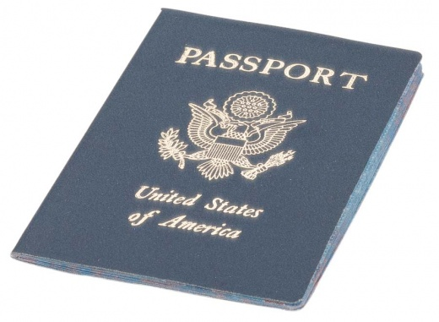
Worldwide Private Exclusive Travel Membership
Your Participants can be a part of an exclusive group that has access to hotels and vacation properties local and worldwide at a discounted price! This membership allows ordinary people to experience Travel Savings 85% of the time than what other online travel sites offer.
Our Fundraising Product

Slide 5
Worldwide Private Exclusive Travel Membership
Private Membership Booking Portal
Prices Includes Taxes (resort fees additional)
Personal Concierge Service (groups)
Book Cruises, Car Rental, Airfare, Activities & Excursions
Bonus Weeks (jaw dropping weekly vacations)
Experience, Wine Club, Restaurant Savings, Shopping Rewards & Emergency Travel Services
Our Fundraising Product

Slide 6
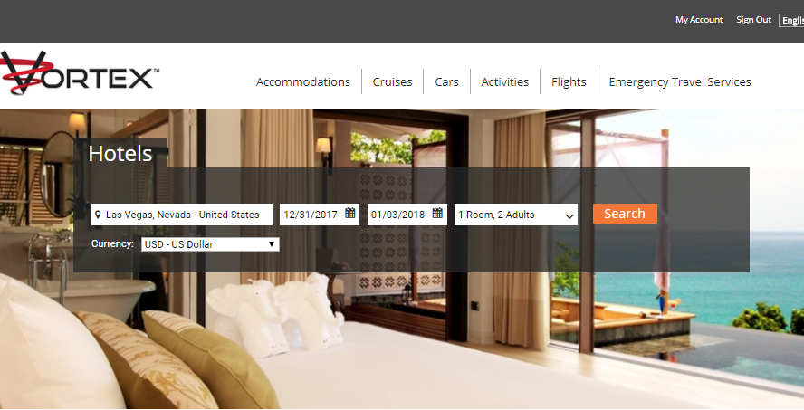

Slide 7
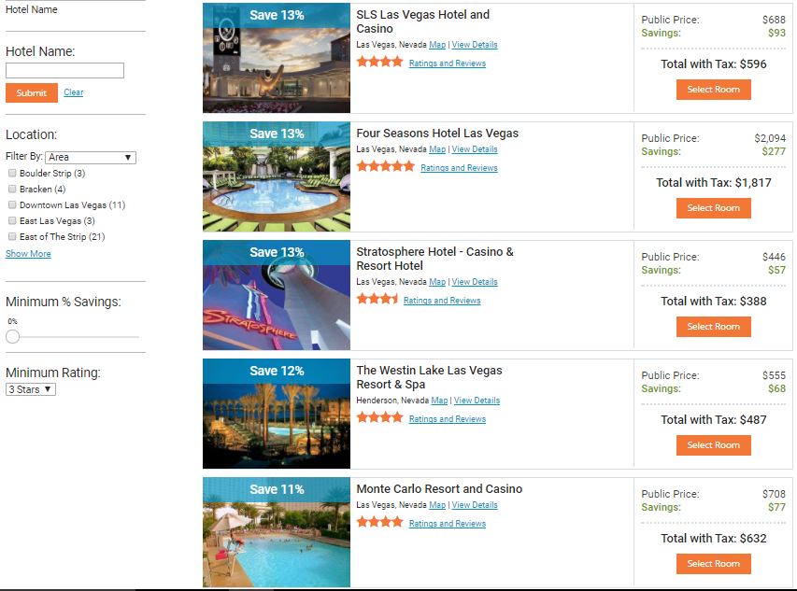

Slide 8
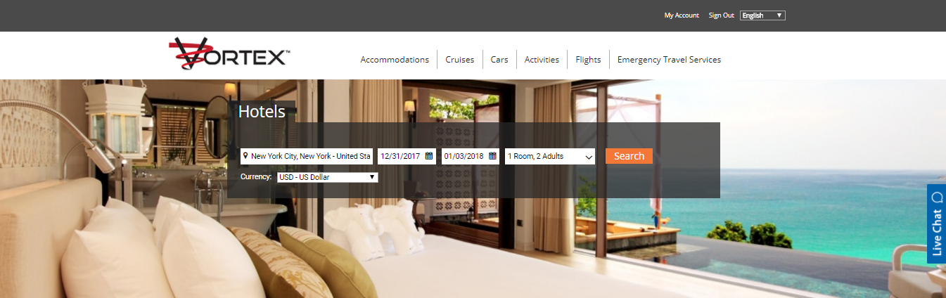

Slide 9
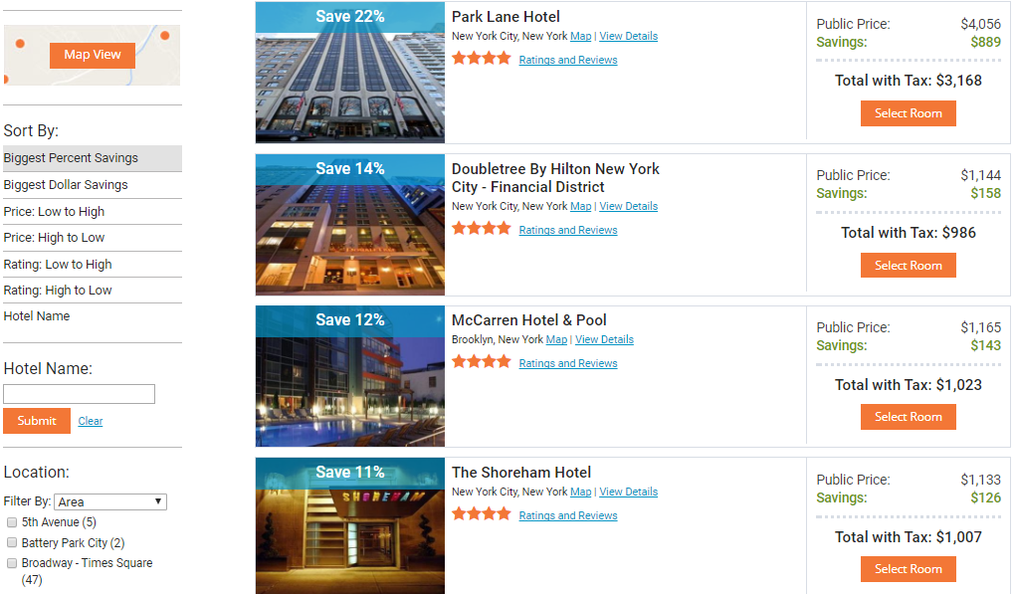

Slide 10
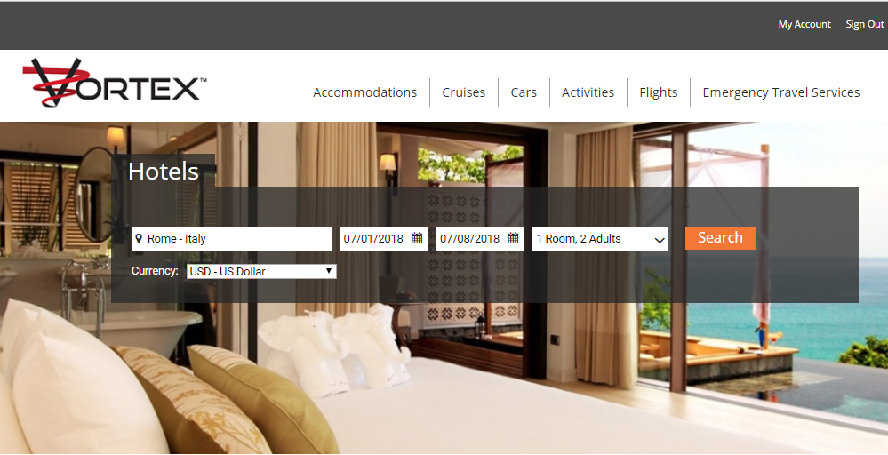

Slide 11
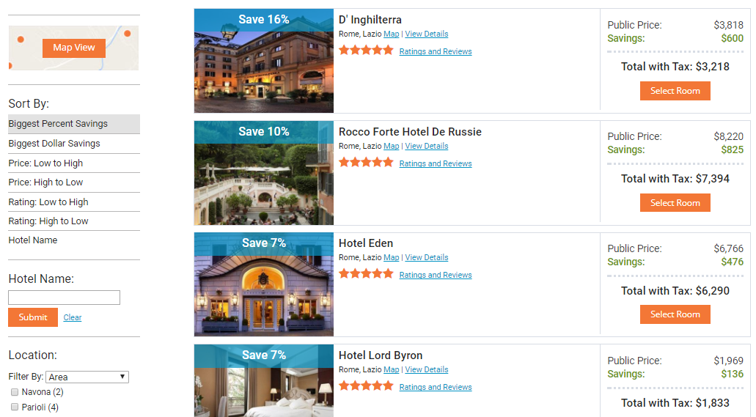

Slide 12
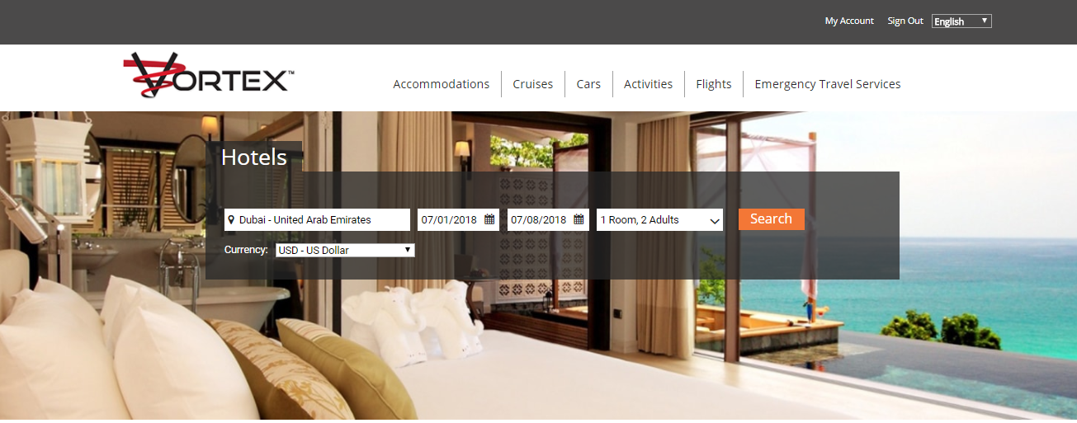

Slide 13
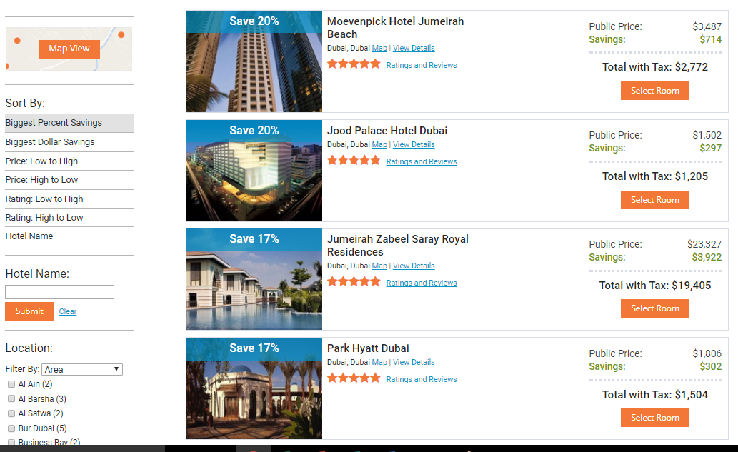

Slide 14
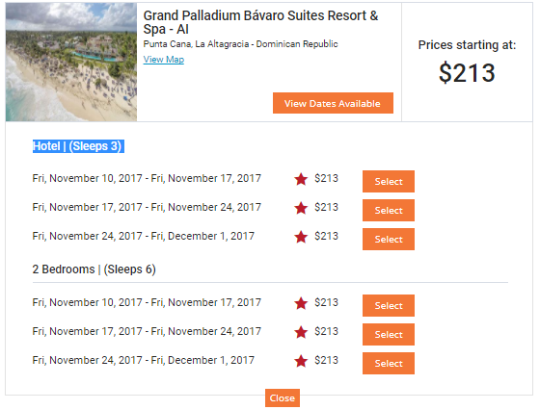
BONUS WEEKS

Slide 15
Worldwide Private Exclusive Travel Membership
Retail Value Between $5,000 to $10,000 with $1,000 a Year Renewal
Our Program is Only $199 (initial fee) + $49.95 mo.
No Renewal Fees
Month to Month Membership (no contracts)
2 People per Membership
No Limitations or Black Out Dates
Savings 85% the time
Our Fundraising Product

Slide 16

Based on Processed Memberships
MEMBERSHIPS | $15 GUARANTEE | SURGE BONUS | TOTAL
20 | $300 | $100 | $400
21 - 29 | $315 - $435 | $100 | $415 - $535
30 - 39 | $450 - $585 | $150 | $600 - $735
40 - 49 | $600 - $735 | $150 | $750 - $885
50 - 59 | $750 - $885 | $450 | $1,200 - $1,335
60 - 69 | $1,500 - $1,770 | $450 | $1,950 - $2,220
70 - 79 | $1,050 - $1,185 | $1,500 | $2,550 - $2,685
80 - 89 | $1,200 - $1,335 | $1,500 | $2,700 - $2,835
90 - 99 | $1,350 - $1,485 | $2,000 | $3,350 - $3,485
100 - 109 | $1,500 - $1,635 | $2,750 | $4,250 - $4,385
110 - 119 | $1,650 - $1,785 | $2,750 | $4,400 - $4,535
120 - 129 | $1,800 - $1,935 | $3,000 | $4,800 - $4,935
130 | $1,950 | $3,050 | $5,000
Our Fundraising Sliding Scale

Slide 17

40 Day Campaign
Create a promotional flyer with incentives
Set Times and Dates to Present the Program in Groups
Select a Group Effective Date
All Applications Held Locally Until Processed
All members will Receive a Membership Packet
Bank Draft for payment
Paper to Online application
Our Fundraising Campaign

Slide 18
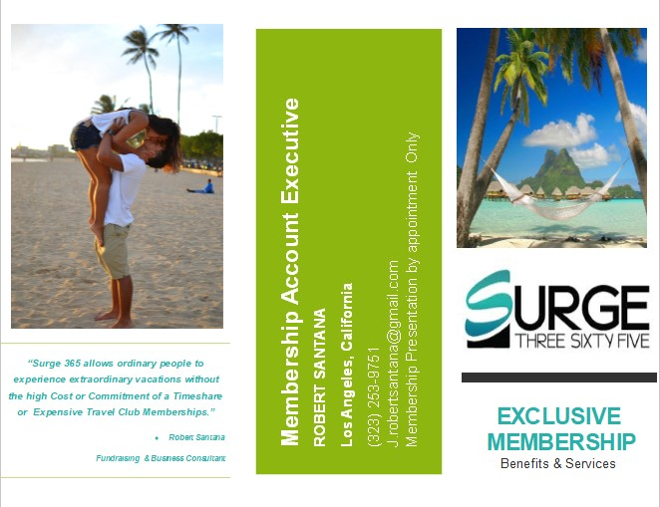


Slide 19
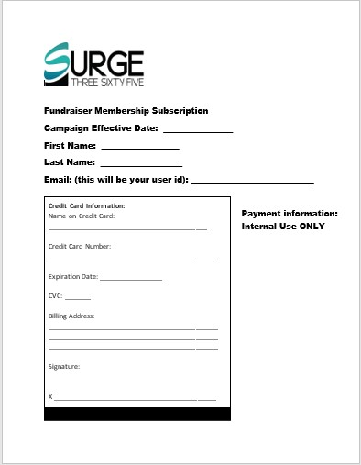

Slide 20
Fundraiser
Program
Questions and Answers

